Slide 1
L00187850 – Philip Stewart
Final Logical Diagrams of Building and Site

Slide 2
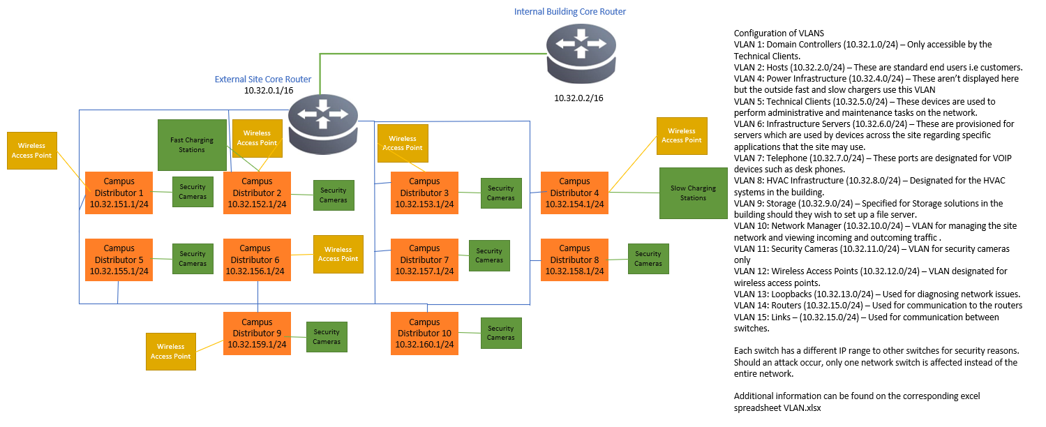

Slide 3
